Slide 1
Weekly Schedule
Today: Between now and Saturday, you will need to start brainstorming topics with your group and researching potential datasets. Your focus should specifically center around:
Selecting a Topic: Find quality service
Finding a Dataset
Finding Inspiration
"Sketching" your ideal visuals
Creating a 1-Page Proposal
End-of-Class Saturday: You will need to create a 1 page proposal. The proposal should include:
A brief articulation of your chosen topic and rationale
A link to your dataset(s) and a screenshot of the metadata if it exists.
3-4 screenshots of relevant "inspiring" visualizations that frame your creative fodder
A sketch of the final design
A link to the primary GitHub repository you'll be housing your work in
March 12, 14, 17, 19; Project Work
March 21: Presentations!

Slide 2
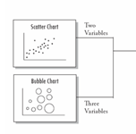
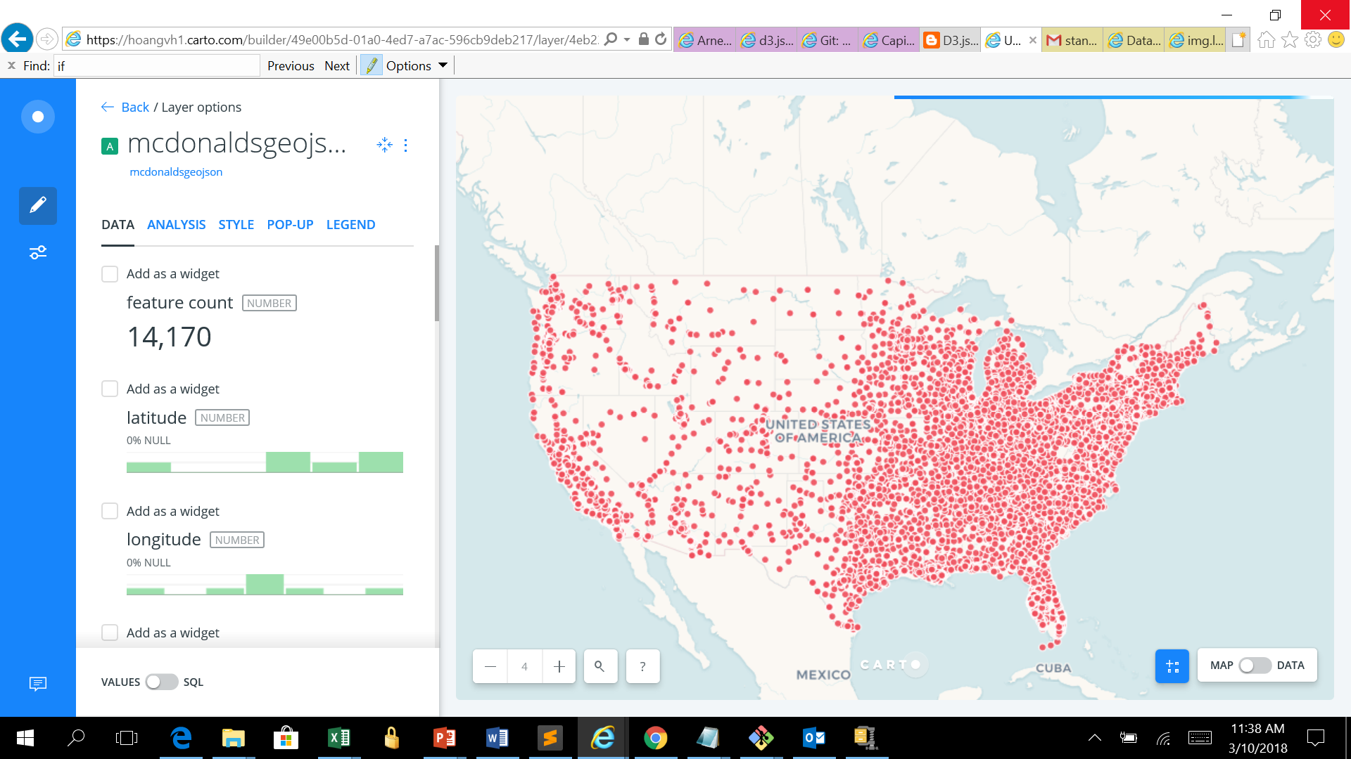
One page proposal
Topic and Rationale:
The topic is Health Care quality services offered in each state. We’d like to analyze, design and develop a website with search ability to provide users information on the types of health care services, as well as the quality and rating, location and license information of each service providers, so that the users can make informed decisions.
Link to datasets: https://github.com/weldeszx/Data-Viz-Project/tree/master/Raw_Data
Screenshots of relevant “inspiring visualization
Link to GitHub repository: https://github.com/weldeszx/Data-Viz-Project

Slide 3
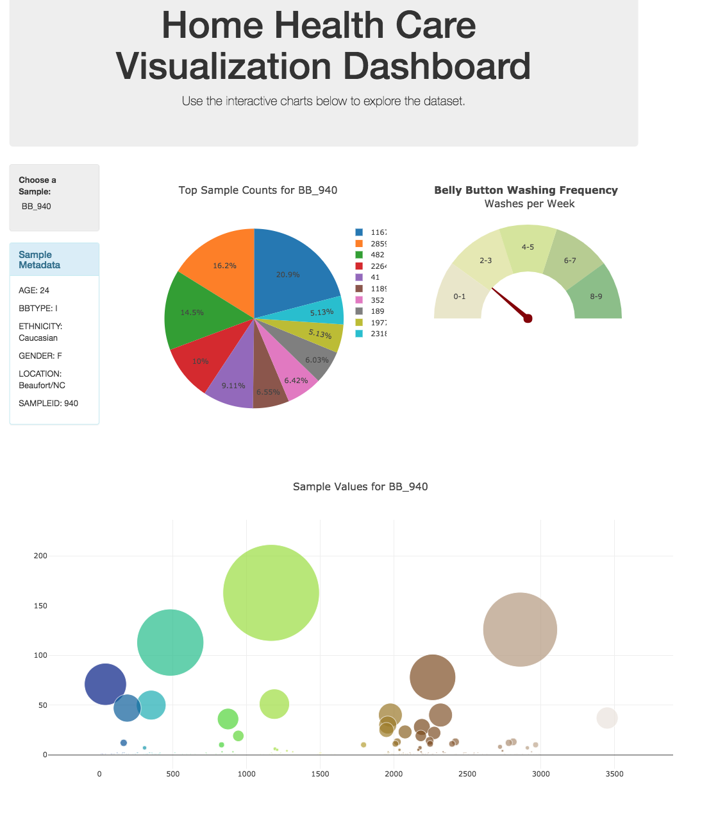
A sketch of the final design

Slide 4
Work plan
Map:
shows all states• The number of service providers• The type of services each service provide offer• Search boxes for city, state, county, service type, ratings
Charts with filter
Bar charts: x-value: state y-value: # of providers drop box: type of services (1, 2, 3, 4) drop box option
Type of services combination (1, 1&2, 1&3, 1&4, 2, 2&3, 2&4, 3, 3&4, 4) service rate: by color•
Pie chart: 4 diff. services: # of services for each city and each state (drop box)•
Dashboard of service quality

